Slide 1
CAP 4453 Robot Vision Final Presentation
Boyang Wu
UCF ID: bo726798
boyang1724@gmail.com
Studying Computer Science at University of South Florida

Slide 2
Paper 43 - Less is more: zero-shot learning from online textual documents with noise suppression(∗)
Authors - School of Computer Science, The University of Adelaide, Australia
Ruizhi Qiao,
PhD student on Computer Vision and Machine Learning
Lingqiao Liu
Postdoctoral Research Fellow
Chunhua Shen
Professor of Computer Science
Anton van den Hengel
Professor of Computer Science

Slide 3
Notes(*)
(*) The first two authors contributed to this work equally. Correspondence should be addressed to C. Shen.
Looked this up and it seems like authors are ordered by degree of involvement in the work, with most active contributors listed first, otherwise they may be listed in alphabetical order instead.
In Computer Science in general the principal contributor is the first in the author list. However, the practice of putting the principal investigator last in the author list has increasingly become an accepted standard across most areas in science and engineering.
https://en.wikipedia.org/wiki/Academic_authorship#Order_of_authors_in_a_list

Slide 4
Abstract
Classifying visual concepts from associated online textual source (i.e.. Wikipedia) with zero-shot learning
Add one more factor: Textual representation is usually too noisy for zero-shot learning.
Researchers want to design a zero-shot learning method that is capable of suppressing noise in text
Uses an l2,1-norm based objective function which can simultaneously suppress the noisy signal in the text and learn a function to match the text document and visual features.
Also develop an optimization algorithm to efficiently solve the resulting problem.
The proposed method significantly outperforms those competing methods which rely on online information sources but with no explicit noise suppression.

Slide 5
Zero-shot learning
Solving a task without receiving training examples of the task (unlike what we did with Adaboost/TensorFlow in our class)
It is an effective way for large scale visual classification
Do not need to collect training data
Key component is to find intermediate representation to bridge between seen and unseen classes
Can learn connection with image features, then transfer connection to unseen classes
Even unseen classes can be classified through learned connection
Zero-shot learning can require laborious human work

Slide 6
Introduction
Develop an automatic zero-shot learning
Use online text documents like Wikipedia
Documents are noisier due to excessive wording
Existing research has already been done on the subject
However earlier works show low performance due to noise
This research takes it a step further by suppressing noise
How to discard some words but still keep the relevant ones?
Use a noise suppression algorithm along with zero-shot learning

Slide 7
Method
How?
Learn from a matrix V to optimize objective
Add noise suppression to an existing formula from prior works
Lots of equations that come from linear algebra
Experiments
1st part
Evaluate proposed method and compare against previous methods
2nd part
Analyze noise suppression of proposed method to find what information in a document is useful for zero-shot learning

Slide 8
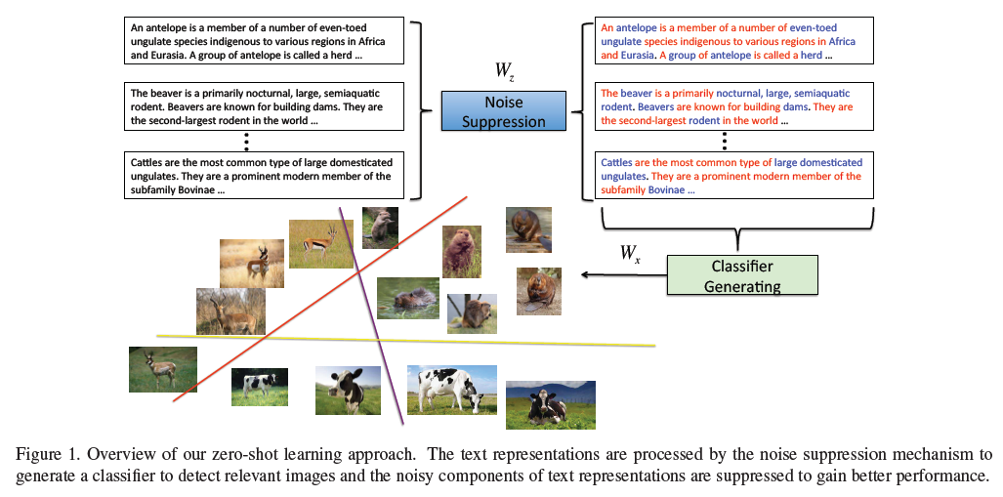

Slide 9
Conclusion
Compare results against other prior algorithms
This approach outperforms all other methods using online text sources
Only gets beaten by methods that use human specified fine-grain attributes
Noise has significant impact on zero-shot deep learning
Some words removed by noise suppression could have more meaning when pieced together
Three types of words after de-noising
Attributes describing the category
Words weakly related to the category
Non-informative words to humans (could show distribution patterns among categories)
*Note that due to testing on similar bird species, some are so close in terms of description that Wikipedia articles may not have good enough descriptions.
Could improve performance by using high quality bird watching articles

Slide 10
Paper 51 - Anticipating Visual Representations from Unlabeled Video
Carl Vondrick
Research Scientist, Google
Assistant Professor, Columbia University (Fall 2018)
Ph. D from Massachusetts Institute of Technology
Antonio Torralba
Professor of Computer Science and Artificial Intelligence
Massachusetts Institute of Technology
Hamed Pirsiavash
Assistant Professor for Computer Vision and Machine Learning
University of Maryland, Baltimore County

Slide 11
Abstract
Researchers want to anticipate actions and objects before they start or appear
This is a difficult problem in computer vision
Requires using extensive knowledge of the world that is hard to write down
To do this, the researcher want to use readily available unlabeled video
Present new framework that uses temporal structure in video to learn to anticipate actions and objects
Train deep networks to predict visuals in the future
Experiment the new idea on two datasets
1s in future and 5s in future

Slide 12
Introduction
Computer vision that can anticipate actions and objects make robots and machines smart
This results in increased convenience for humans
Can be used for recommendations, predictions, etc.
However, creating such an algorithm is extremely difficult
Humans use accumulated knowledge, but what do machines have?
Why videos?
Having consecutive frames mean image order is already established
Prior research has been done on this matter, but generally require self-supervision which is expensive to scale

Slide 13
Anticipating Visual Representations from Unlabeled Video
Goal is to predict future frames within a video
Use recognition algorithms on forecasted representations
Used 600 hours of unlabeled video to train the network 1 to 5 seconds in the future
Also used video from THUMOS (400 hours) to quantify performance
Forecast actions and objects by applying recognition algorithms
Finally evaluate the idea on two datasets of human action in television shows and egocentric videos of daily life

Slide 14
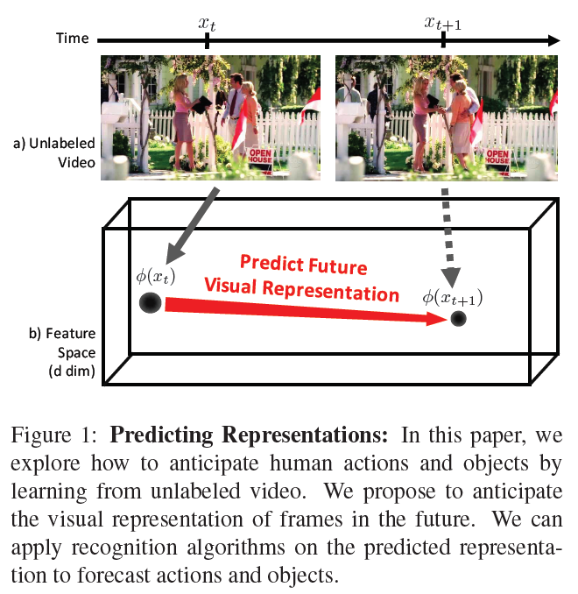
Previous work done before
Prediction with unlabeled video
Predicting actions, human path, and motions
Big data (visual)
Unsupervised learning in vision
Representation learning

Slide 15
Method
Use convolution (5 layers)
Last layer is output vector – this makes the prediction
Formulas
Euclidean loss to minimize distance between predictions and representation of future frame
Predicts the last hidden layer of Alexnet
Can obtain large amounts of data since data does not need to be labeled
Use deep regression to decide between multiple futures
Ran on i7 3.4Ghz CPU

Slide 16
Conclusion
Depending on algorithm settings, action predictions can achieve between 30 and 43% accuracy
Method is still far from human performance (70-85% accuracy)
Better than competing computer methods (25-35% accuracy)
Object prediction is between 20 and 200% better than computer methods
However, method can help machines anticipate some objects and actions
Predicting visual representations is better than predicting pixels (difficult) or anticipating label categories (supervision)

Slide 17
Paper 73 - Fast Unsupervised Ego-Action Learning for First-Person Sports Videos
Kris M. Kitani
Cooperative Research Fellow in the Institute of Industrial Science at the University of Tokyo
Assistant Research Professor in the Computer Vision Group, Robotics Institute, School of Computer Science
Courtesy appointment in the Electrical and Computer Engineering (ECE) department at Carnegie Mellon University
Takahiro Okabe
Ph.D. in Information Science and Technology
Department of Artificial Intelligence
University of Tokyo

Slide 18
Authors continued
Yoichi Sato
Professor at Institute of Industrial Science
University of Tokyo
Akihiro Sugimoto
Professor for Digital Content and Media Sciences Research Division
National Institute of Informatics, Tokyo

Slide 19
Abstract
1st person POV action cameras are becoming common among sports enthusiasts
Discover 1st person action categories (called ego-actions)
These can be useful for video indexing and retrieval
In order to learn categories, researchers investigate use of motion-based histograms and unsupervised learning algorithms to cluster video content
Approach assumes unsupervised scenario, without labeled training videos
Videos are not segmented, and number of categories are unknown
Use in-house and public Youtube videos to categorize across various sport genres
Approach outperforms other topics models in terms of classification accuracy and computational speed
10 minute video can be indexed in under 5 seconds

Slide 20
Introduction
Action cams are becoming more popular, so there are more videos
Since there are more videos, indexing and searching for videos may be difficult
How do we classify and search everything?
Say you want to review a third jump of the second trial in a ski jump video
This experiment will try to solve that
Searching can be done to quickly go to the desired location in the video
Can be done with color-coded times

Slide 21
Prior work?
None when looking for experiments on ego-action categorization from 1st person sports videos.
Only prior/related works are vision-based POV human action for indoor activities with focus on hand gesture recognition.
Sign language recognition
Context aware gesture recognition
Object recognition
Hand tracking
Body sensors have been used in other experiments

Slide 22
Method Basics
Unsupervised method is the best as to reduce human labor
Close to real-time processing is needed so users won’t have to wait long for results
Extracted video features should be discriminative enough to differentiate between actions categories but also robust enough to deal with extreme ego-motion
Due to the nature of ego-motion (POV movement) there are large amounts of motion parallax, motion blur, rolling shutter, and more within videos
However, POV videos only have a single sport per video, and actions would look similar across videos due to the nature of the sport
Actions of the same sport share similar image distortion due to similar movements

Slide 23
Method Basics 2
Use a simple global representation of motion that is robust and discriminative
Use the Dirichlet process on real-world problems [1]
Dirichlet is a stochastic (random) process to find a distribution over distributions.
Similar to Gaussian process
Distributions are discrete, but cannot be described with finite number of parameters
Provide a new labeled benchmark dataset for standardized analysis of outdoor POV sports videos
Ran on Nvidia T40 Tesla GPU
[1] https://www.stats.ox.ac.uk/~teh/research/npbayes/Teh2010a.pdf

Slide 24
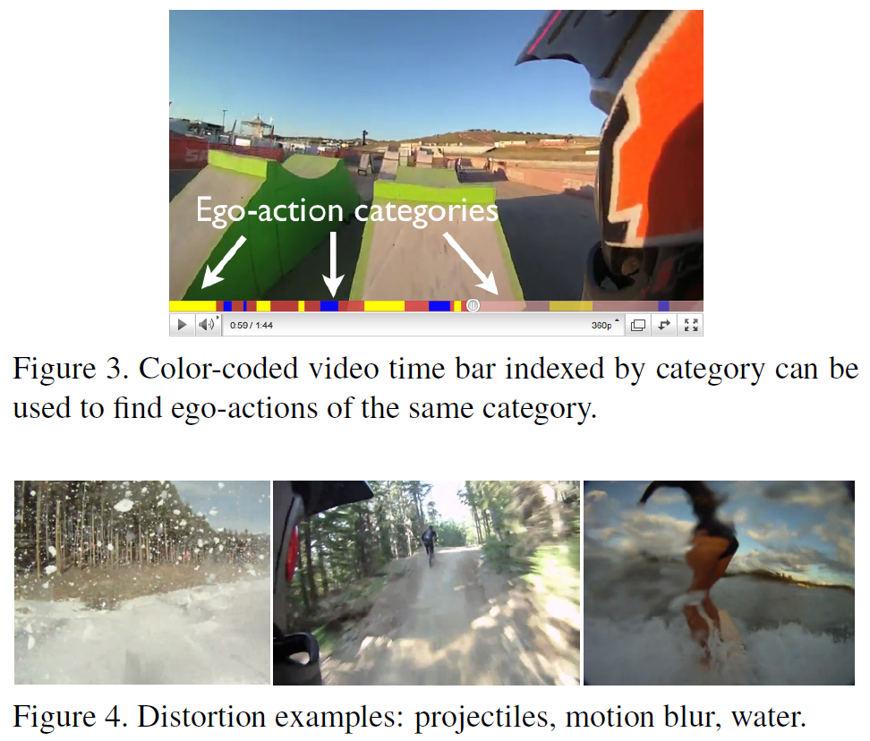
Motion Feature Extraction
POV sports footage is very noisy
Need to find representation of motion that is robust in
comparison to the distortion
Use optical flow vectors
Quick movement can create false flags
Observe general direction and magnitude instead for consistency
Use RANSAC to extract consistent flow vectors
This is an iterative method to estimate parameters
Robustness further added by converting sets of flow vectors to histograms

Slide 25
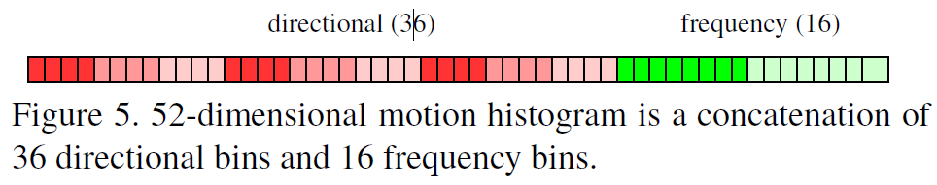
Motion Feature Extraction 2
Two types of motions needed to discern
Instantaneous motion (direction)
Turning you head is more directions
Encoded with a 36-bin histogram
4 flow directions
3 flow magnitudes
3 flow variance (difference of flow magnitude compared to average flow magnitude)
Periodic motion (frequency)
Running and walking is more frequent
Done with a Fourier Transform over average flow magnitude
Encoded with 16-bin histogram
Frequency components are thresholded and normalized
Histogram from both are merged to show a final motion histogram

Slide 26
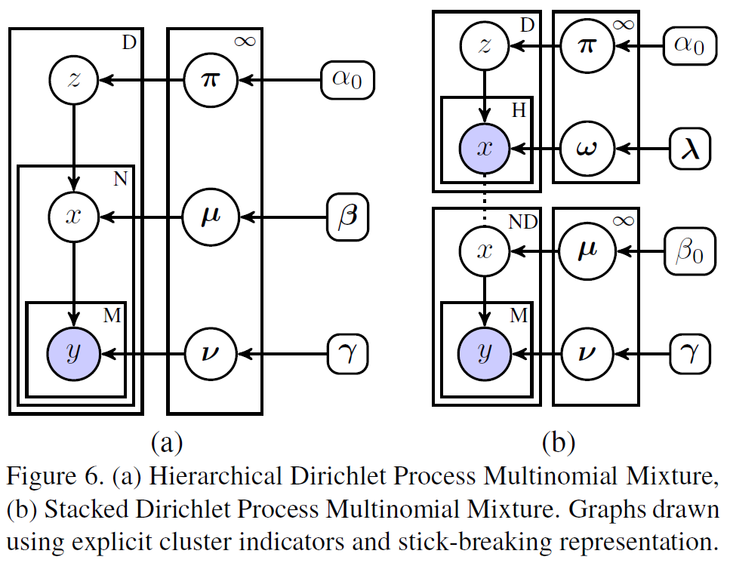

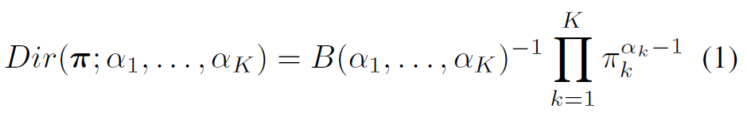
Dirichlet Process (DP)
Use a stacked Dirichlet Process Mixture (DPM)
Similar to a big urn with many biased K-faced dice
Single draw from urn yields one biased K-faced die
Expected value of probabilities is defined as
The Dirichlet distribution is useful when working with K dimensional histograms (2 in this case)
Histogram is interpreted to be created from multiple passes, so likelihood of histogram becomes a product of probabilities
Result is another Dirichlet distribution

Slide 27
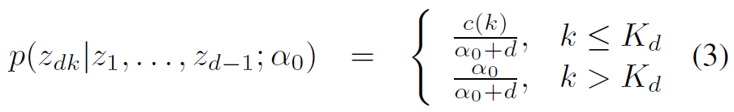
Chinese Restaurant Process (CRP)
Alternative way to explain Dirichlet Process
It is a process of generating a probability distribution PI from DP
Probability distribution would be like a normal graph or histogram
CRP and DP both generate a discrete probability distribution PI

Slide 28
Stacked Dirichlet Process Mixtures
Experiment uses a single DPM and posses the results to second DPM to learn ego-action categories
Stacking makes it so topics are organized by hierarchy, and all tops at each level of hierarchy have the same discrete set of observations (motion histograms)

Slide 29
Task of Inference
Single video is cut into X equal sized video splices (by time)
Each video splice is made up of N frames (60 in this case)
Set of motion histograms Y are generated from each frame in the video then input into the model
Output Z is another set of motion histograms of ego-action indices
These contain ego-action cluster assignment for each video splice
Total number of ego-action clusters is then estimated
Everything is unsupervised learning
Motion codebook is learned
Ego-action categories are discovered
Codebook is learned and histogram accumulated efficiently over each video splice in a single pass of data.

Slide 30
Motion Cookbook
Output from the first DPM is a sequence of codeword assignments in histogram X
Each indicator variable in the histogram has been assigned to a codeword H that increases probability for later
Outputs Y of all past motion histograms
This data can be decomposed into
Current prior over cluster assignments
Likelihood of observed motion histogram

Slide 31
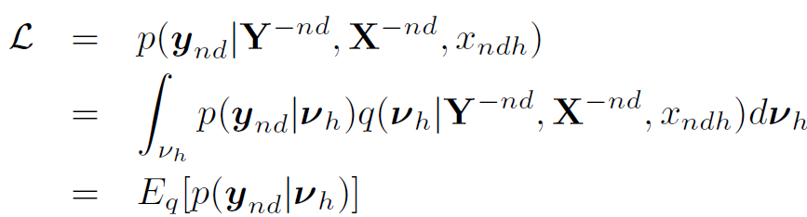
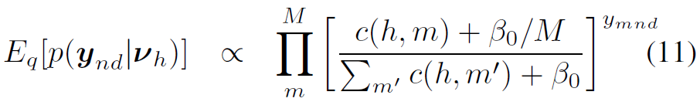
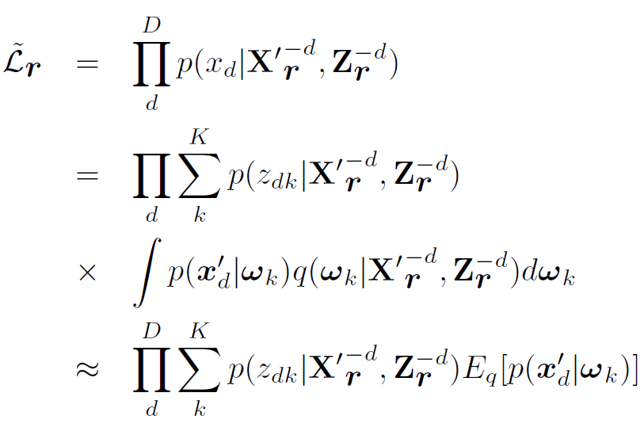
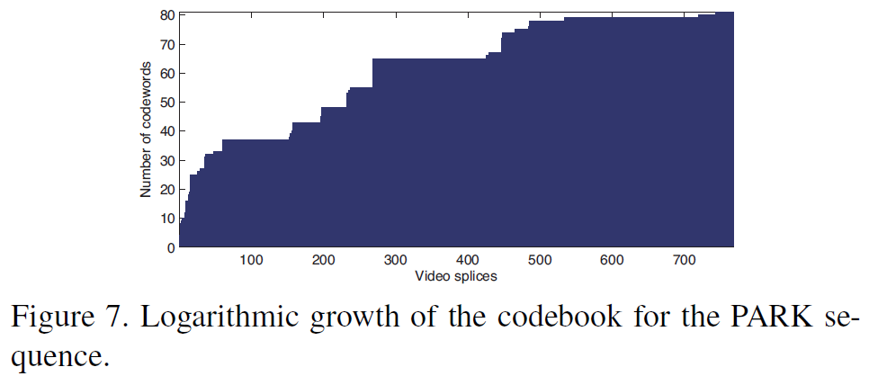
Lost of difficult formulas

Slide 32
Some explanation
So those formulas are all above me at my current level
But in general, they are used to calculate various things, such as codewords from the videos, checking over past distributions, and count of flow vectors accumulated from all histograms
The inference algorithm here adds some new codewords and order is preserved when added to previous codewords
Codebook length is log bounded in terms of how many codewords it can have

Slide 33
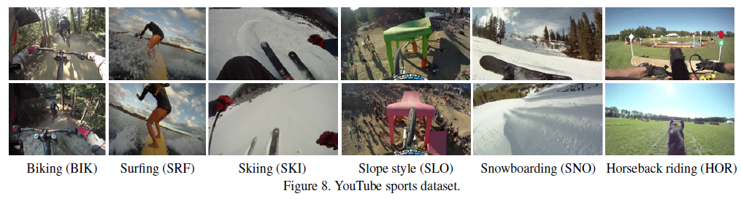
More explanations
Histograms are again decomposed, then inference is performed for every frame
Run inference several times to search for more clustering

Slide 34
Discovering Ego-action Categories
Run controlled experiments on many videos to observer performance across various sports
First choreographed video (QUAD) uses 124 video splices and 11 different ego-actions categories
Used to show how design of motion features affect performance
Second video (PARK) is a 25-minute workout video with 766 video splices and 29 different ego-action categories
Used 6 Youtube videos (previous page) to check performance
All sequences were recorded with a GoPro HD

Slide 35
Matching Categories
Use F-measure for performance
Found one-to-one correspondence between ground truth and discovered actions
Did a search to identify best match between single ground truth and discovered action
Keep repeating until done
If there are extra discovered categories, these are later appended to the original list but have an F-value of 0 (not used)
Average F-measure is computed from weighted average of each category

Slide 36
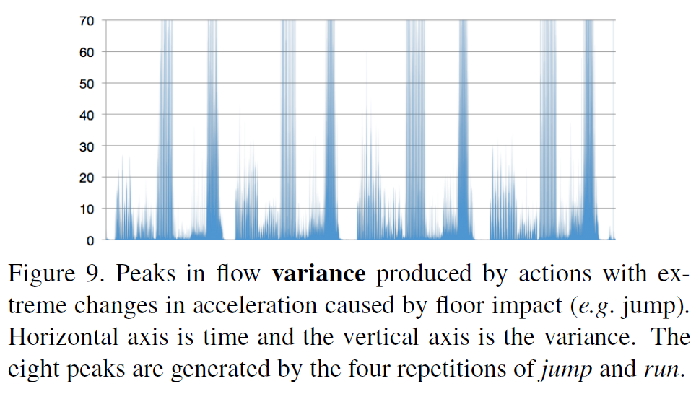
More
Recall flow direction has 4 directions
Magnitude has 3 bins and are divided into small, medium and large motion magnitudes.
Variance between actions were also divided into 3 bins like magnitude

Slide 37
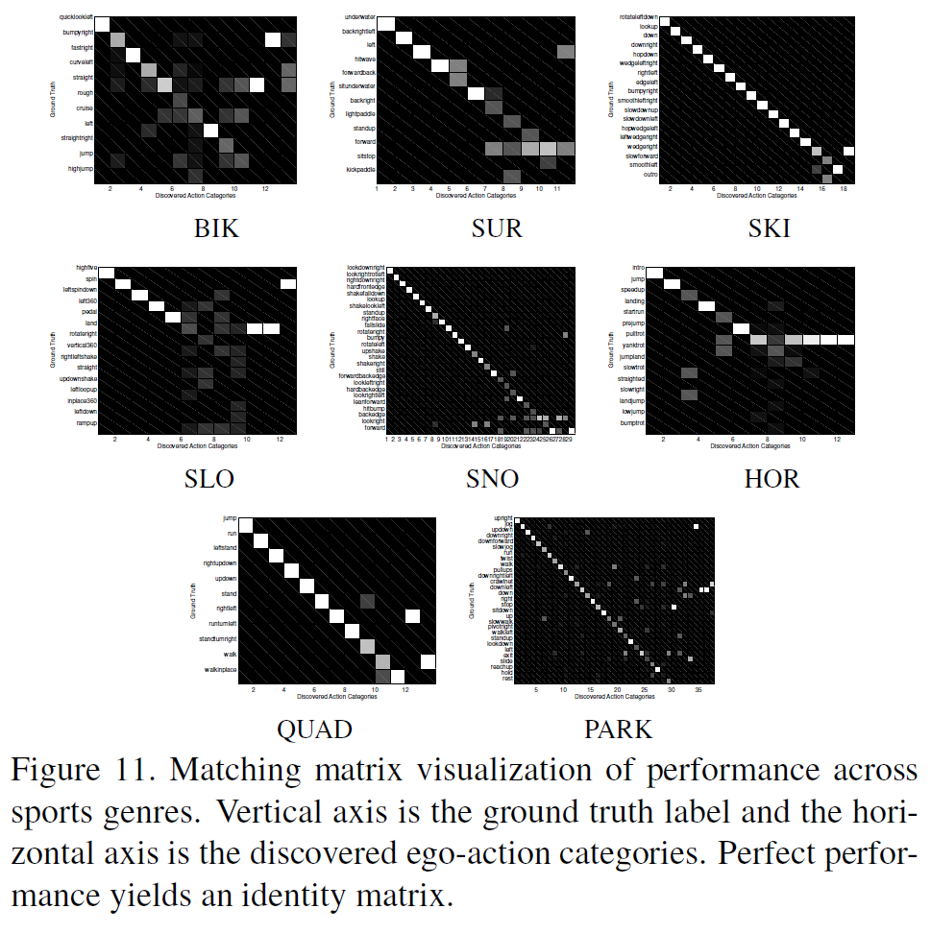
Performance
F-value max of 1.0
Skiing, surfing, snowboarding average 0.6
Horseback riding, mountain biking,
Slope style below 0.6
Some sports having more discernable actions,
Thus the result
Proximity also had effect

Slide 38
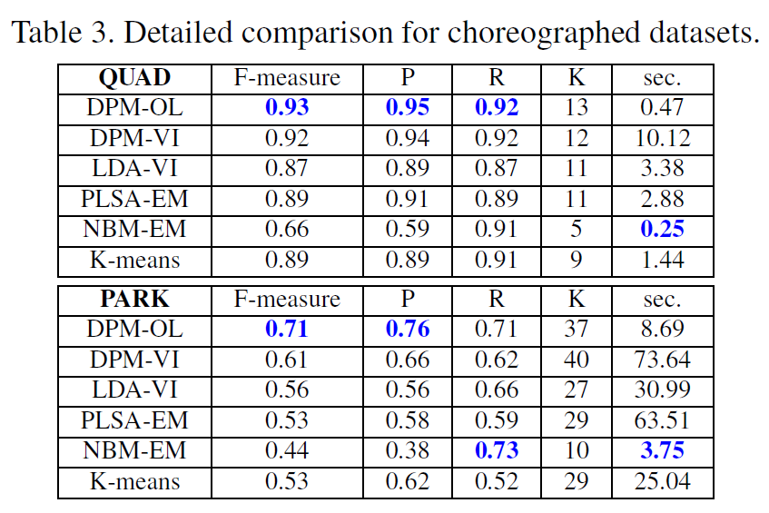
Comparison
Online inference test works the best
Non-DP models underestimate true K value
Method is second in speed next to Bayes
Average compute was less than 1 second for
2 minutes of video (60 segments)
DPM variances took significantly more time due to complexity
All tests performed on 2.66Ghz CPU

Slide 39
Conclusion
Introduced a new way to discover ego-action categories from POV sports videos
Dirichlet process was used to infer motion codebooks and ego-action categories with no training data
Shown that DPMs can be applied to real-world problems without costing too much compute complexity.
Online inference can perform on part with other approximate inferences over models, while saving in computational cost
Vision-based ego-action analysis can be successfully applied to dynamic POV videos

Slide 40
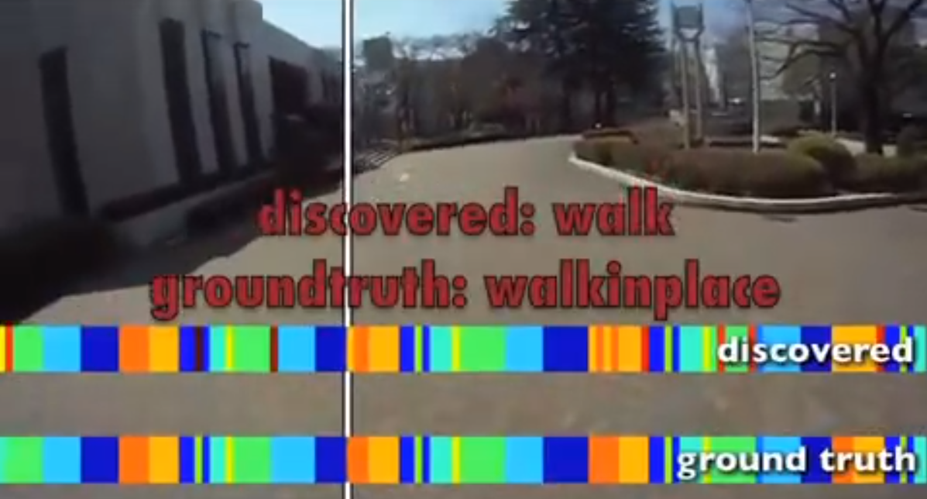
Results
https://www.youtube.com/watch?v=42pVGWAQOVU
Video of discovered vs ground truth results from the experiment

Slide 41
Thank you!

